Slide 1



NEW PROGRAM DEVELOPMENT EVALUATION
For CobbleStone Learning Centers
,Shanmukh Sai Yadav Godha

Slide 2
PROJECT MANDATE
This project aims to analyze Cobblestone Learning Center's learning outcomes on SkillAdvantage program experiments and evaluate the experiments' validity. A survey to determine the preference and attitudes of online and center-based program will also be covered in this project.

Slide 3
Highlights
Program A had most students enrolled
Program B yields the best learning outcomes in the view of all subjects, especially in Math Section
Program A has better improvement in Verbal Section

Slide 4

Survey Questions
Demographic and Attitude Survey Questions

Slide 5
What is your current grade level?
Which district do you live in?
Grade 7
Grade 8
Grade 9
Grade 10
Grade 11
Grade 12
Choose from one of the districts where CLC operates
Other, please specify
Demographic Survey Questions
- Total of 5 questions
- 2 will be answered by parents
- 3 will be answered by students
- Possible demographic varibales that can be used for segmentation
Notes:
Our survey consists with two parts which are demographic survey questions that aim to help segment our respondents, and survey questions that's focused on knowing our respondent's attitudes toward online courses, and what are some potentially obstacles that may prevent them from switching to online course.
- listed are structure of demographic survey questions.
- top two are examples for our demographic survey questions and their respective answers.
- Answers will be different from each question

Slide 6
Demographic Survey Questions
Questions responded by parents or guardians
Which annual household income range best describes yours?
What best describes your household composition?
What is your current grade level?
Questions responded by students
Which district do you live in?
How many free hours can you allocate each week?
Notes:
Here are our complete set of demographic survey questions.

Slide 7
I am confident in my ability to support my child’s education during on-center learning.
Strongly Disagree | Disagree | Neutral | Agree | Strongly Agree
o | o | o | o | o
Attitude Survey Questions
- Total of 5 questions
- 1 will be answered by parents
- 4 will be answered by students
- Aim to assess respondent's perception about online courses
Notes:
Here is an example for our attitude survey question
- answers will consists of different degree of agreeableness, from strongly disagree to strongly agree

Slide 8
Attitude Survey Questions
Questions responded by parents or guardians
I am confident in my ability to support my child’s education during on-center learning
Questions responded by students
I can easily gain stable access to the internet
I think taking courses online will not negatively affect my participation
I am comfortable with distance learning applications
I prefer online teaching than in-person

Slide 9
SkillAdvantage
Program
Experiments Analysis
Enrollment and score by district

Slide 10
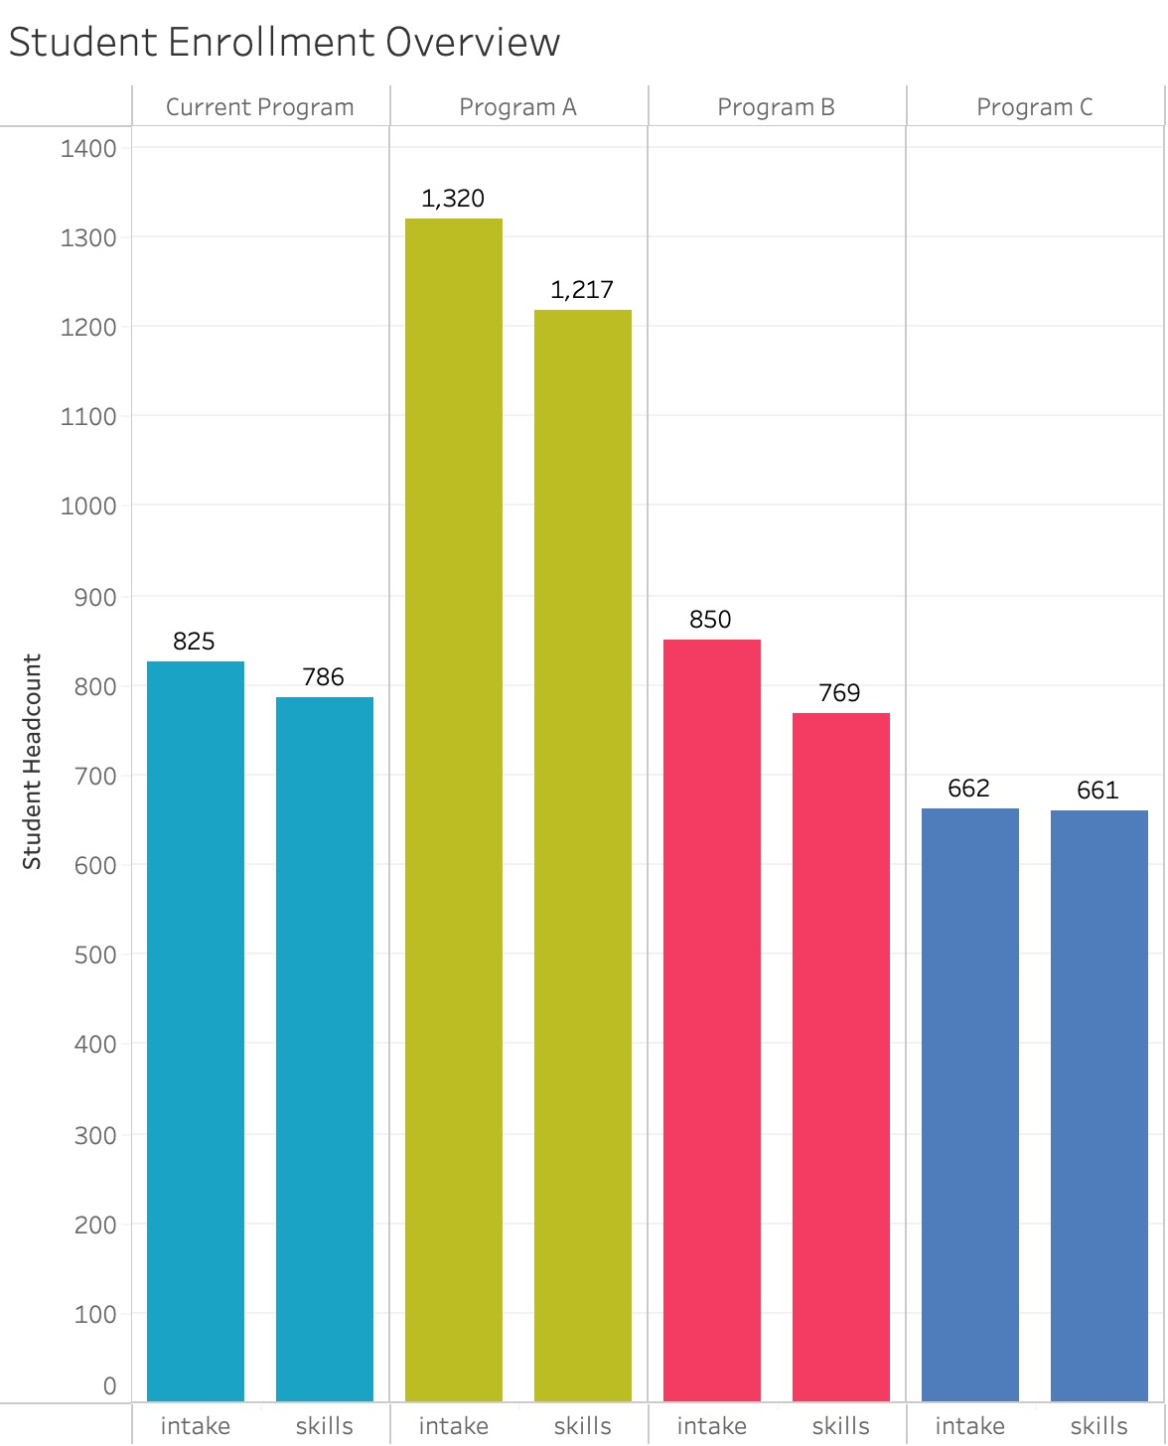
添加副标题
Program A had most students enrolled.
Not all enrolled students retake assessment tests.

Slide 11
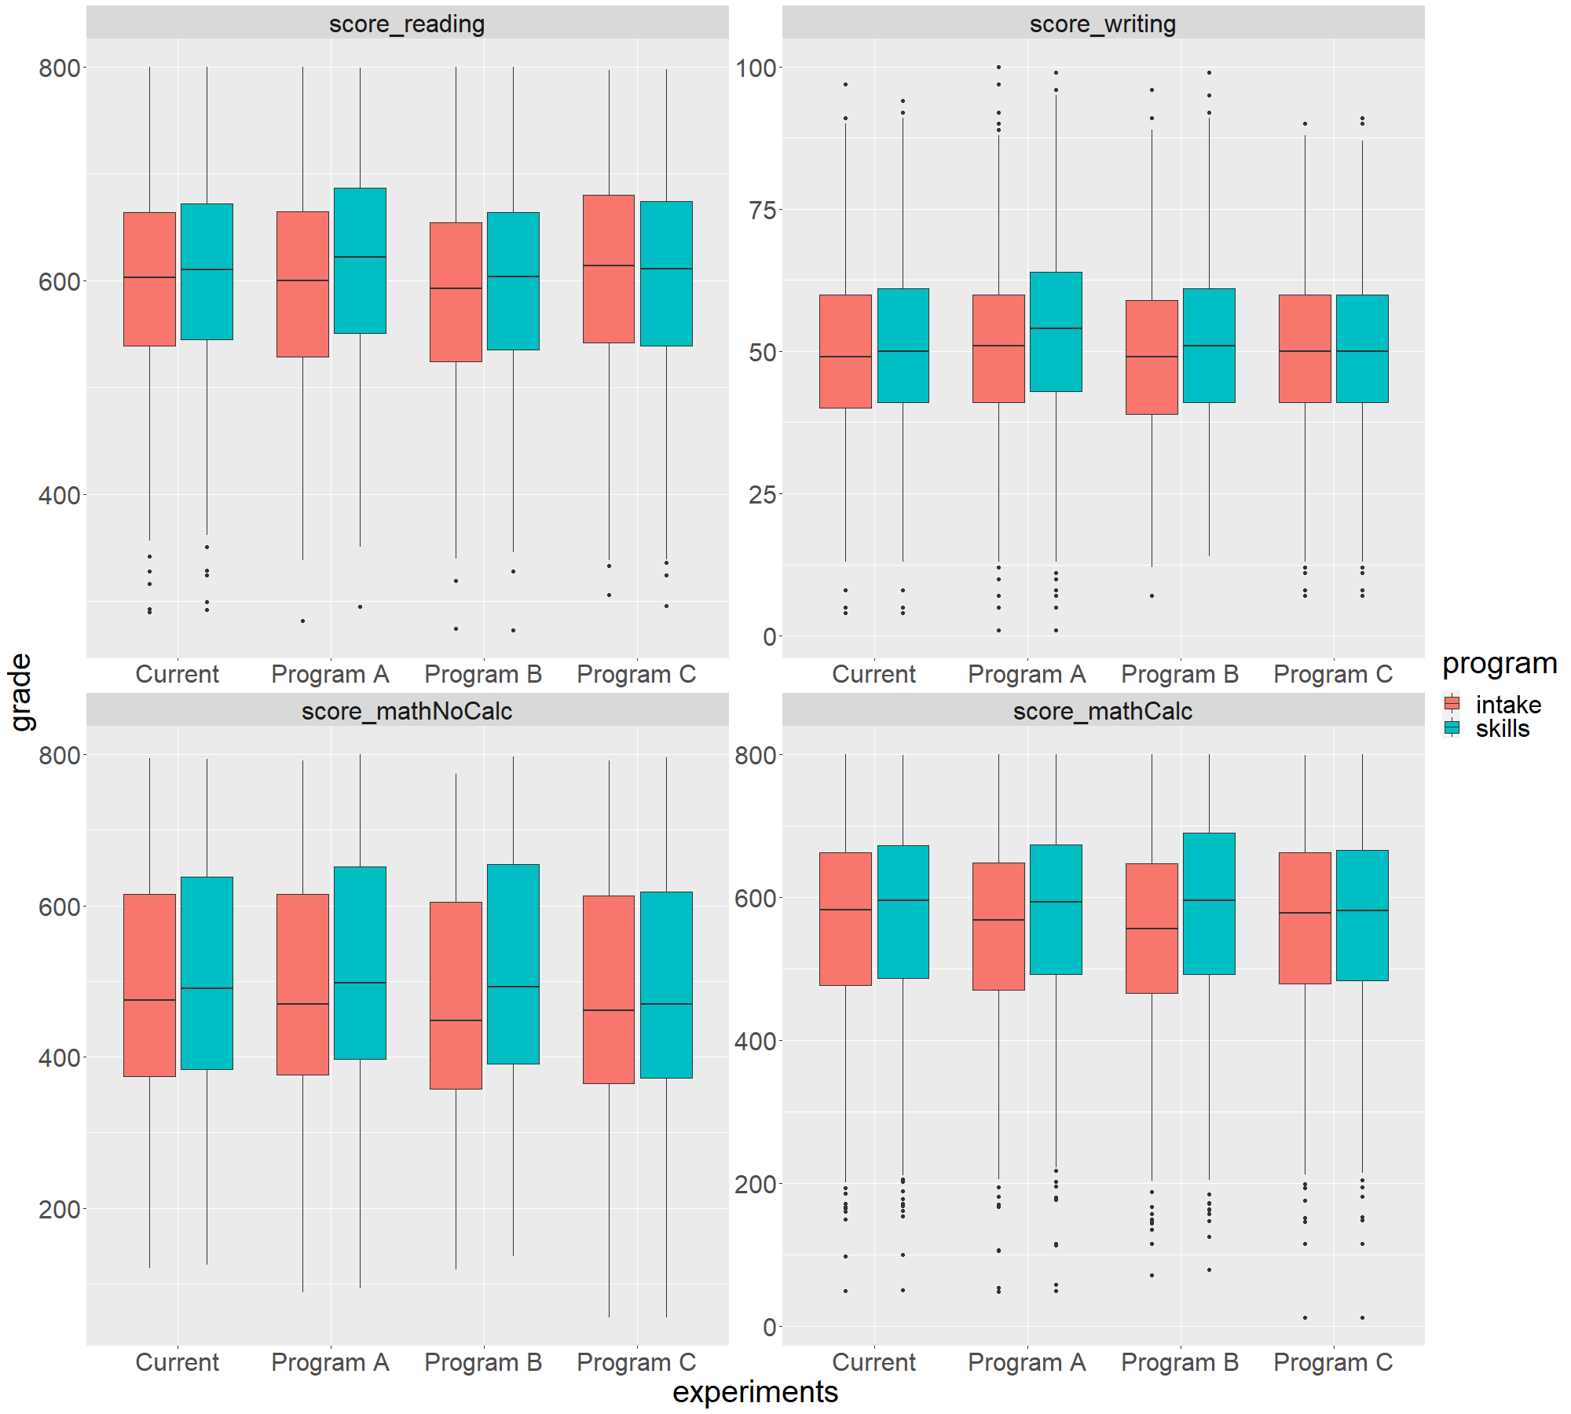
Overview of learning outcomes in experiments
Initial intake scores vary slightly between different programs
Program A and B have a positive improvement on students' learning outcome
Program C has little change on students' academic performance
Notes:
1. as we can see, program b has the lowest median intake score compare with other program
2. however, program B has the best overall score improvement
3. next, lucas will further explain program performance by subject

Slide 12
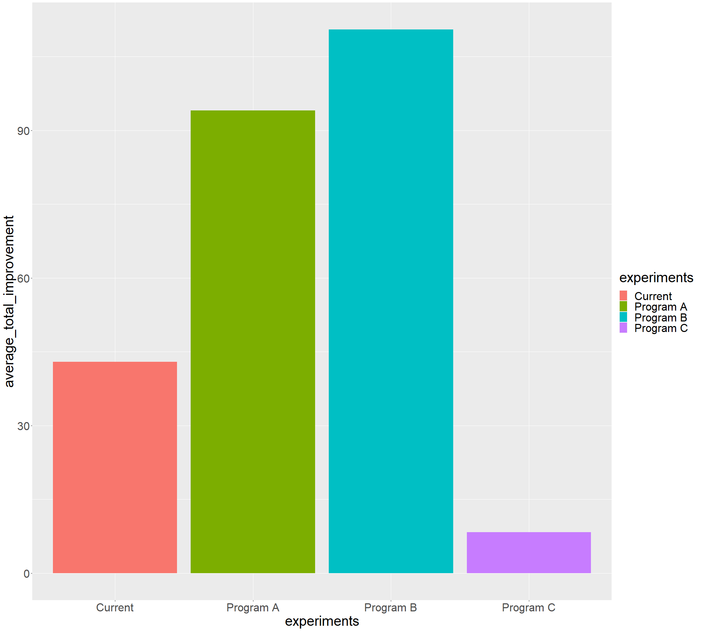
Average total score improvement in experiments
110.48
94.03
Program B yields best learning outcomes in the view of all subjects
42.96
8.35
Notes:
This graph shows the overall improvement in each program's student learning outcomes. We can see that student in program B has the highest score increase after they finish the program, which is 110.48 in four subjects. Program A is relatively lower, but still has a great performance. However, program C seems has little improvement on student's learning outcomes, which only results in a 8.35 improvement in four subjects. Next, we will see the detailed impact on four subjects from these four programs.

Slide 13
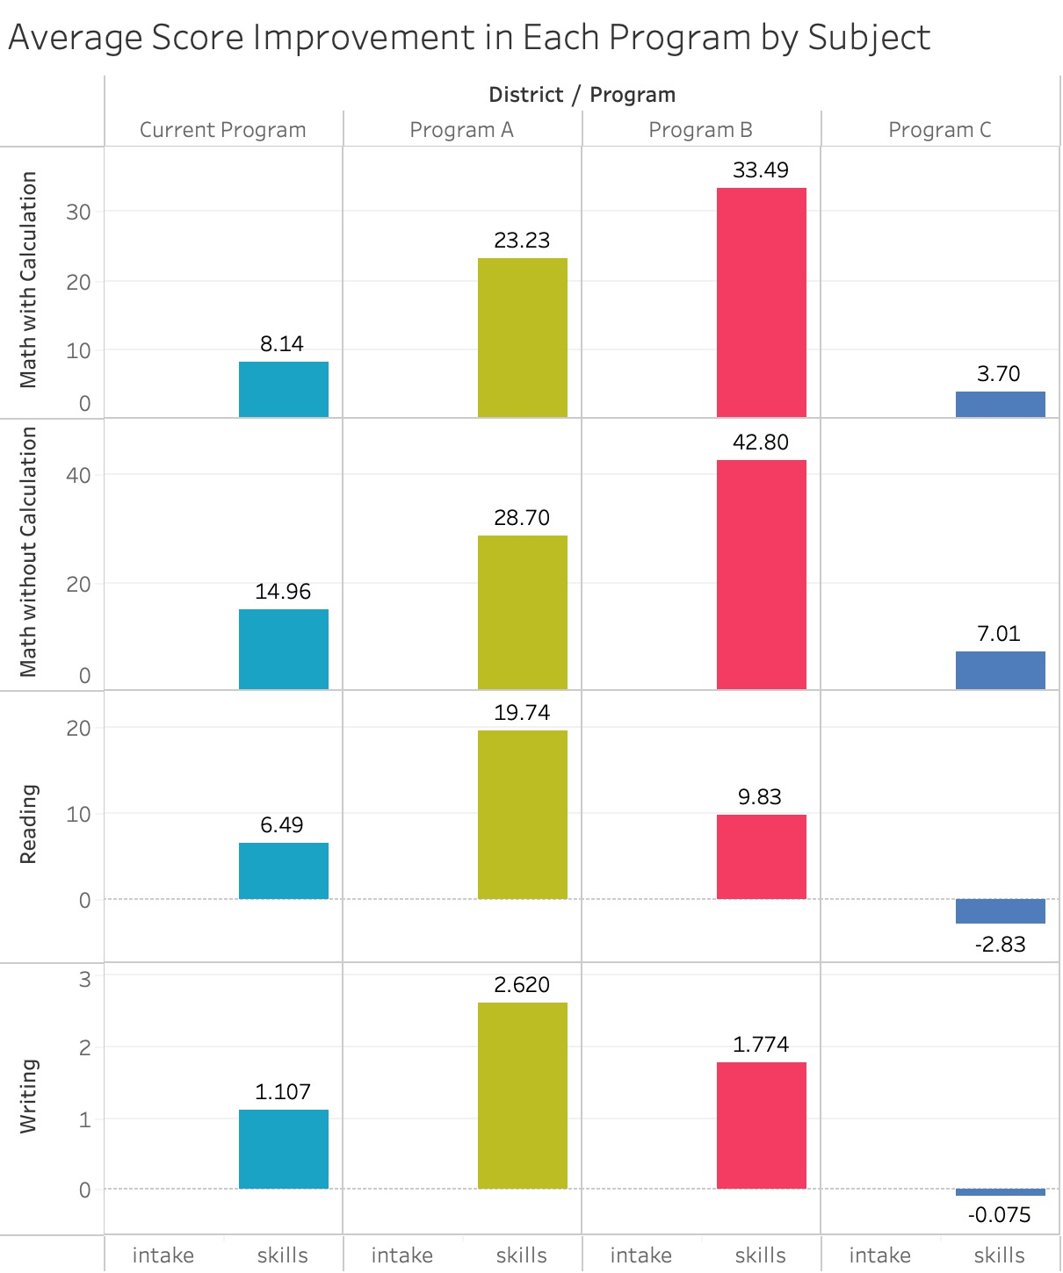
Program B has highest scores improvement in Math Section.
Program A has highest score improvement in Verbal Section.
Notes:
In this graph, we can see that program C performs even worse than current program. It also has a negative impact on students' writing skills. Program A works well in the reading and writing subjects. It yields 19.74 improvement in students' reading performance, and also 2.62 in the writing performance, which is the highest among all programs. As we mentioned before, program B has the best performance in the view of all four subjects. Moreover, it works particularly well in the two math subjects, which yields 33.49 in calculation math and 42.8 in no calculation math.

Slide 14
Experiments Evaluation
Examine differences by teaching location

Slide 15

We recommend assign students randomly to four different programs in specific districts to improve experiment
Teaching styles and outcomes may vary between districts
Students' academic performance varies between districts

Slide 16


Recommendations
Adopt Program B
Program B has proven to be effective; we believe adopt this program will be beneficial
Implement the reading and writing teaching method of Program A in Program B
The reading and writing courses of Program A are more effective, because of better teaching methods.
Assign students randomly to four different programs in specific districts to improve experiment

Slide 17
Appendix

Slide 18
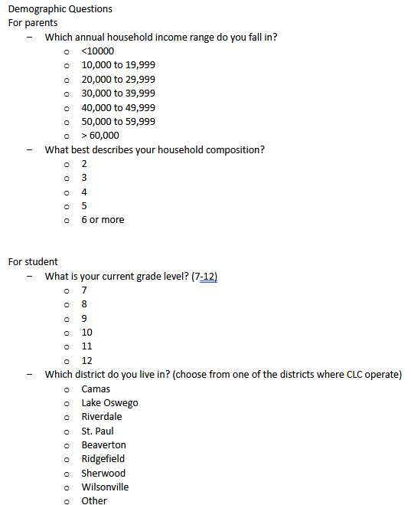
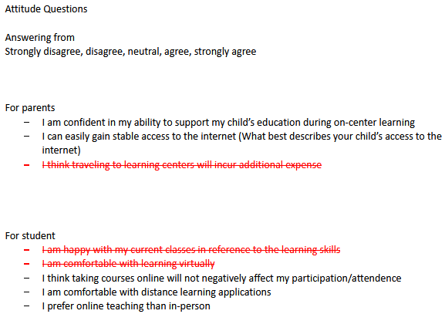
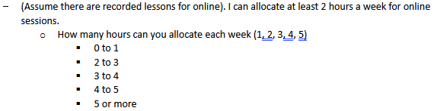
Full Survey Questions

